Slide 1
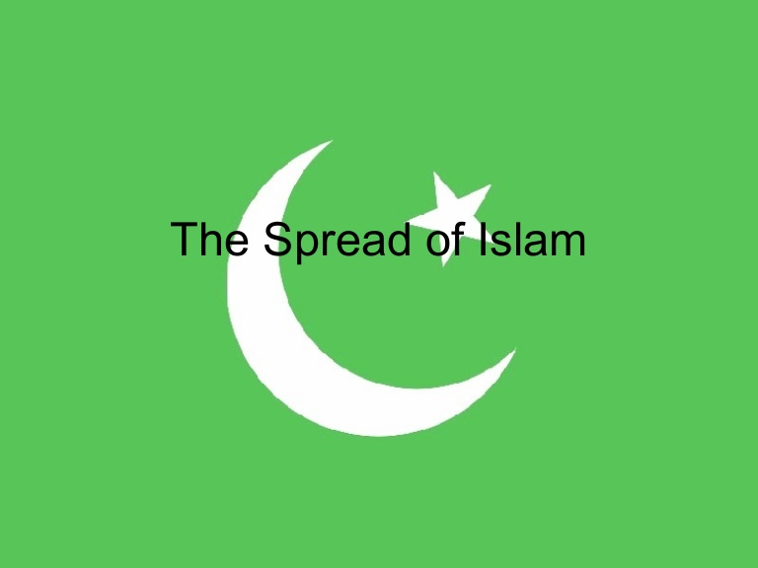
Notes:
There may not be a more important topic in our study of church history, at least for our present day and age, than that of the rise of Islam. Many have wondered how it could possibly be the fastest growing religion when every bit of it was founded upon falsehood, deception, and intimidation. The answer to this question is that many don’t have the facts concerning Islam and how it came about. Studying the roots will help us to see how it grew and continues to grow.
You might have heard that there are similarities between Christianity and Islam. Both of them are monotheistic, believe in Abraham and the prophets, acknowledge Jesus, and have a holy book. But when you truly investigate, there are few similarities. Muslims might use the same words as Christians, but they have different meanings. Muslims will tell you they believe in Jesus and love Him. But to them He is not the eternal Son of God who left heaven’s glory and died on that cruel cross for our individual sins and then rose victorious the third day from the grave to conquer sin, death and hell. How can they claim to love and honor Jesus when they dethrone Him and do not recognize Him as the eternal Son of God who is the Savior of the world? The world rioted when one man published a cartoon of Muhammad a few years ago, yet Muslims make a mockery of Jesus by making the Son of God just another prophet and one Who Muhammad superseded.

Slide 2
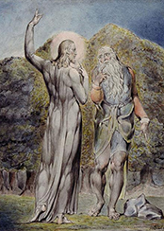
Satan Finds a Niche
Matt 12:43-45 – “⁴³Now when the unclean spirit goes out of a man, it passes through waterless places seeking rest, and does not find it. ⁴⁴Then it says, ‘I will return to my house from which I came’; and when it comes, it finds it unoccupied, swept, and put in order. ⁴⁵Then it goes and takes along with it seven other spirits more wicked than itself, and they go in and live there; and the last state of that man becomes worse than the first. That is the way it will also be with this evil generation.”
Notes:
When Muhammad began Islam, he did so in a time period where true, biblical Christianity was sparse and weak and therefore the world was not ready to respond to it with the same courage it did when persecuted by Rome. A good illustration of the problem can be seen by considering what Jesus said in Matt 12:43-45 about the unclean spirit who goes out of a man.
Jesus speaks from the point of view of a demon evicted from its home. He has been displaced, and is obviously unhappy about it. He travels, “seeking rest, and finds none”—a miserable, unsatisfied existence. Then he says, ‘I will return to my house from which I came.’ When he comes back, he finds it empty, swept, and put in order (Matt 12:44). The unclean spirit attempts to again possess the man who was his home—and finds the man more than willing to have him back! Not only is he allowed entry, but the house is empty, swept, and put in order—ready for demon habitation! “Then he goes and take with him seven other spirits more wicked than himself, and they enter and dwell there; and the last state of that man is worse than the first”(Matt 12:45). Finding his home far better than he left it, he decides to bring seven worse spirits so they can all live together and torment this man. Truly does Jesus say, “the last state of that man is worse than the first”.
Though the church of Jesus Christ was rescued from the domain of darkness and started out strong, Christians of this time period have allowed themselves to become corrupted. Many are merely nominal Christians with no true conversion. As a result, circumstances were prime for the devil to use other men to bring destruction and make things worse than they already were. Islam was a tool of the devil to further corrupt a world where Christianity had become more of a name than an actual practice.

Slide 3
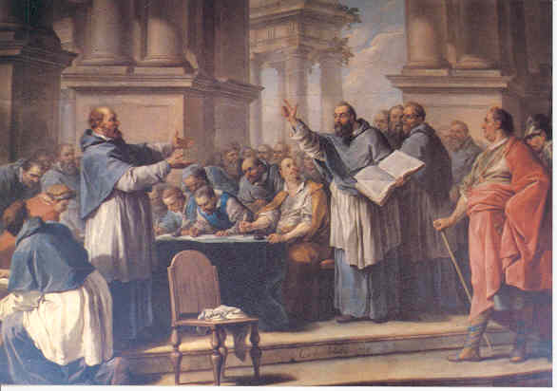
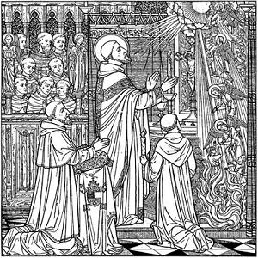
State of the Christianity
Lost enthusiasm it possessed when the subject of persecution
Had depended on the state to bring others into its fold
Christians spent more time persecuting/fighting each other
Monasticism robbed the church of many who might defend it
Eastern church became too formalized with no heart
Notes:
Several things were happening during this era that it made it easier for a false religion like Islam to spread so rapidly:
When the church was suffering from persecution, it was stronger. As Tertullian said, the blood of martyrs was the seed of the church. Once Christianity became legal and then later the official religion of Rome, apathy set in and enthusiasm was lost. Ritualism set in as the Catholic church came to power and there was no heart or zeal. This weakened the influence of Christianity and allowed another false religion to stake its claim on the world.
The church had depended too often on the Roman state to bring others into the fold of Christianity through the numerous wars and battles it fought. This institutionalized evangelism rather than letting it do its natural work through individual influence.
There was so much dissension occurring in the church with Gnosticism, Donatism, Arianism, Neoplatonism, fighting amongst the bishops, etc. that it bred division which weakened the church. Christians spent more time fighting each other than they did converting lost souls and building one another up.
Monasticism robbed the church of thousands who might have its defenders and strongest lights. Because these men could not find the proper balance between being in the world but not of the world, their isolation further weakened the church and its influence in the world.
The Eastern church was weakened by its formalized worship and those Christians became apathetic as a result.

Slide 4
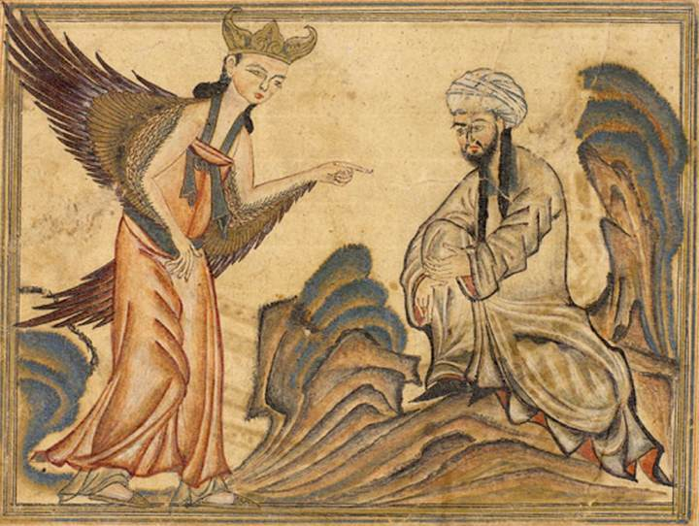
Muhammad (570 – 632AD)
Born in Mecca
From shepherd to merchant
Came into contact w/corrupted forms of Christianity, Judaism, and heathenism
Developed “Islam” from these teachings
Opposition to his teaching in Mecca was so strong he had to flee to Medina
Islam well received in Medina. Within 10 years, Muhammad was master of Arabia
Notes:
Islam began in Mecca and claimed to be the revelation of God (Allah) through the angel Gabriel to a man named Muhammad. Muhammad was born in approximately AD 570-571. He was born to the powerful tribe of the Quraish in Mecca. His father's name was Abdullah. His mother's name was Aminah.
Apparently Abdullah was a merchant who made caravan trips. He died on a trading trip soon after his marriage to Aminah, leaving Muhammad fatherless at birth. Aminah, his mother, died when he was only six years old. Muhammad was taken in by his grandfather, only to have him die when Muhammad was eight years old. At this time, his uncle, Abu Talib, one of the leaders of the Quraish tribe took him in and raised him.
Muhammad was taught the family business and was apparently quite successful. A wealthy widow named Khadijah arranged for Muhammad to oversee her trading business, and was so impressed with his skill and appearance that she proposed marriage to him. Muhammad was twenty-five and Khadijah was forty when they married. They had six children, two boys and four girls. Both of the sons died early in life. The daughters lived to see Muhammad become the founder of Islam.
Having married the wealthy Khadijah, Muhammad now became a gentleman of leisure and somewhat of a philosopher. He would retreat from society, take trips into the desert and mountains. He would spend his hours in meditation, greatly concerned about the condition of the civilization he saw around himself. He had a personal mission to find "truth." One of his frequent places of seclusion was a cave on Mount Nur. It was while in this cave, during the month of Ramadan, a pagan festival, that he claimed to have received his first visitation from Gabriel and recited the verses found in Qur'an 96:1-5.
At first, Muhammad shared his new revelations with only his family and close friends. During the next three years the message of Muhammad quietly spread among the people of Mecca, especially among the youth. Then Muhammad is believed to have received instructions from Allah to go public with his message and openly condemn the paganism and idolatry of Mecca. This open condemnation of idolatry became an economic threat to the prosperity of Mecca, and as a consequence, organized opposition to Muhammad and Islam began. At this point, Islam was politically weak, and many Muslims died for their faith.
Persecutions became so great that many Muslims fled to Abyssinia (Ethiopia) for refuge. When Meccan delegates tried to extradite them, after hearing the Muslim's defense, the ruler refused their extradition on the basis that his faith was similar to theirs, and he could not allow them to be harmed.
Muhammad continued to proclaim his message, and his following slowly grew. At one point, in 621, a group of delegates from Medina responded to his call and made a covenant with Muhammad and declared themselves to be Muslims.
A year later, in 622, some seventy people from Madinah made a similar declaration and pledged to fight to protect Muhammad against any and all odds. This pledge or covenant from some who were leaders of Madinah was a turning point for Islam. It provided Muslims with a secure base of operations and allowed them to expand from it. Muhammad commanded the Muslims in Mecca to migrate to Madinah. After some struggle, Medina was declared to be wholly a Muslim community. For thirteen years, Muhammad had preached in Mecca with minimal success. He had followed a quiet, non-political approach and merely preached. Now, however, his tactics changed. He established himself as religious, political, and military leader. Under his guidance, the community of believers became more important than family or tribe. Islam began to be spread through intimidation and force. Entire tribes and cities were "converted" under threat of war or by conquest. Success led to greater success. In the year 630, eight years after he had been forced to leave Mecca, Muhammad returned with such an overwhelming force that the Meccans made no resistance. Muhammad's forces destroyed all the idols of Mecca, and declared the Kabah to be the place of worship for Allah.
With the subjugation of Mecca, Islam became the preeminent power on the Arabian peninsula. Tribe after tribe, city after city declared allegiance to Islam and it's prophet because they were given no choice. Muhammad returned to Madinah and continued to rule his kingdom from there. Muhammad died in 632 at the age of sixty-three. In twenty-three years he established a religion and social order that is still dominant in the Arab world today.

Slide 5
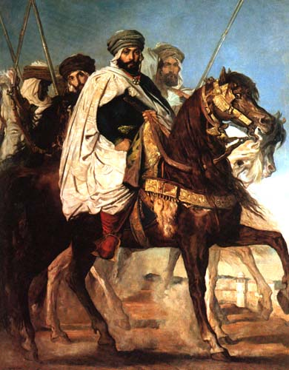
Muhammad’s Followers
After Muhammad’s death, the “caliph” took over leadership
1st: Abu Bakr (father-in-law). Conquered entire Arabian peninsula
2nd: Umar. Conquered Syria, Mesopotamia, Egypt, & Persia
Remaining caliphs spread Islam to Europe, Africa, & Asia
Caliphate eventually evolved into Ottoman Empire which lasted to the 20th century
Two prominent sects (Shiites & Sunnites) divided over who was the legitimate caliph
Due to the wealth of the petro-dollar, Islam has successfully spread over the entire world
Notes:
After Muhammad's death, Islam continued to flourish under the leadership of Muhammad's companions. The first Caliph (successor to the prophet - Kalifah) was his father in law and long time friend, Abu Bakr. In his two years of leadership, Abu Bakr consolidated Islamic influence over the entire Arabian peninsula.
The second caliph was Umar. He was in power from 634 to 644. Under Umar, Syria, Mesopotamia, Egypt and Persia were added to the growing list of Islamic subjects. Others followed, continually expanding the borders of Islam. Under the leadership of the caliphate, Islam spread into Europe, Africa, and Asia. The caliphate lasted centuries, shifting from one dynasty to another, but always claiming the religious right to lead. Eventually the caliphate evolved into the Ottoman Empire which lasted until the early 20th century.
Islam spread as a social system, a political system, and a religious system and it was spread by force of arms. That was its philosophy in the beginning, and it is still the philosophy of Islam today. Today Islam is one of the world's dominant religions, and claims as much as one fifth of the world's population.
Islam claims to be a united religion with no divisions; however, one does not have to be an astute observer to realize that Islam is, in reality, fragmented into many different branches, some of which are militantly hostile to each other. There is no unity among Muslims as they would have us believe. Two prominent groups, the Shiites and Sunnites had their origins around 660 over who was the legitimate caliph. Other sects followed.
With the end of the colonial system, Islamic states were given their autonomy again. With the wealth from petro-dollars, Islam as a religion is being successfully spread over the world. Islam is one of the greatest opponents in existence to the gospel of Christ today, and is one of the fastest growing religions in the world.

Slide 6
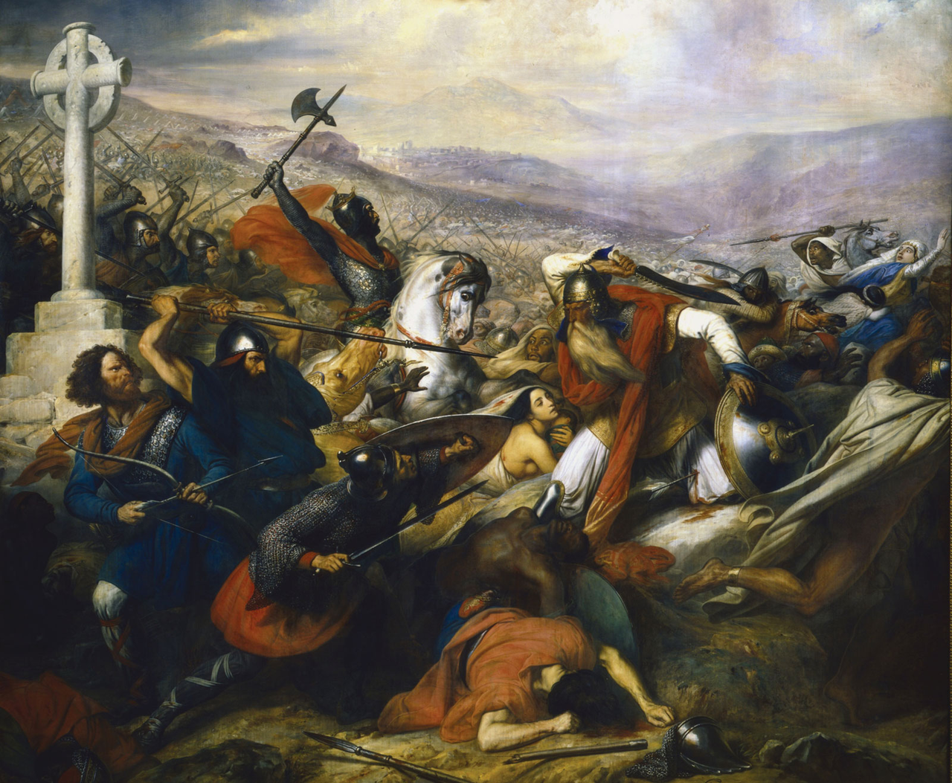
Notes:
The above map shows us how Islam spread in the 7th and 8th centuries. Have you ever wondered what happened to the Christian churches we read about in the bible and that were so strong in the early history of the church? The answer is Islam. While Muhammad conquered all of Arabia and his followers captured Syria, Mesopotamia, Egypt, and Persia, the goal of Islam’s caliphs was to spread Islam to the entire known world.
After spreading through Northern Africa, Islam was finally halted by the Franks. A man named Charles Martel (Charles the Hammer) was the first to successfully fend off the Muslims and prevent them from spreading further into Europe. If it had not been for his efforts, the majority of us with European roots would probably be Muslim today.
On the eastern side, Islam was halted by the Eastern Roman Empire under Leo the Isaurian in 718AD. Though Muslims set up a siege against Constantinople, they could not pierce the mighty Theodosian Walls protecting its land side. Constantinople’s navy proved superior to the Muslims as it used Greek fire and therefore was able to replenish its army and supplies through the sea.

Slide 7
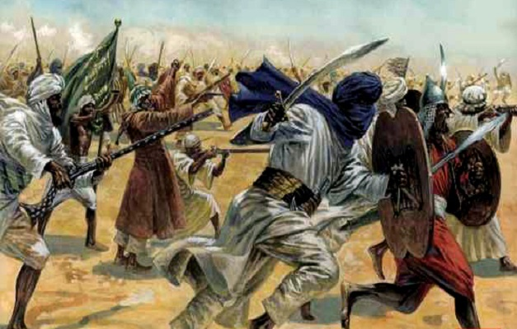
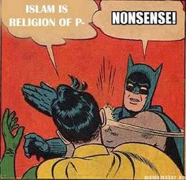
Islamic Conquests
Christians given 3 choices: the sword, tribute, or Islam
Muslims destroyed images in church buildings, accusing the Christians of idolatry
Ended in 750AD when influenced by Greek culture, Muslims set out to build a splendid Arabic civilization in Bagdad
Notes:
When Muslims conquered a nation, it generally gave them two choices: convert to Islam or die by the sword. Some Muslims allowed the nations to keep their religion if they paid tribute, but in most cases the tribute was too high and in some cases it was merely a matter of time before the people gave in.
While Muslims captured nations, they raided church buildings destroying the images that they found while accusing Christians of being idolatrous. This was one thing the Muslims were actually right about that the Catholic church still to this day cannot see wrong.
Once Muslims could not pierce through France and Constantinople, they halted their conquests. One reason was that their forces were severely defeated. But another reason is because they became influenced by Greek culture. Therefore they decided to spend more of their time building a splendid Arabic civilization in Baghdad than capturing more nations for Islam.
If someone tells you Islam is a religion of peace, they are either ignorant of its history or they are lying. Islam’s foundation was built on fear and intimidation tactics. It spread not as a result of people being convinced of the evidence of its so-called truths, but because of the sword. Truthfully, this is all Islam can stand on to be successful because the evidence against its validity is staggering as we will now consider.

Slide 8
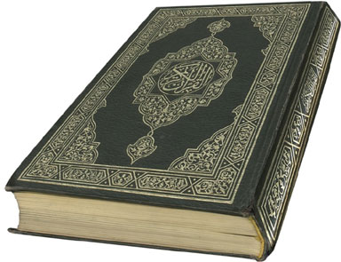
Islamic Teachings
“Islam” means “submission to God”
Muhammad’s teachings gathered and collected in a work called the “Koran”
2/3 length of NT
Arranged in 114 chapters
Longest chapter at beginning of book w/each successive chapter shorter than the previous
Notes:
The term “Islam” means “submission to God”. It’s teachings were gathered and collected in a volume called the Koran. The Koran is approximately 2/3 the length of the NT and is 114 chapters long. The longest chapter is the first chapter of the book and each chapter is successively shorter and the previous with the last chapter being the shortest.

Slide 9
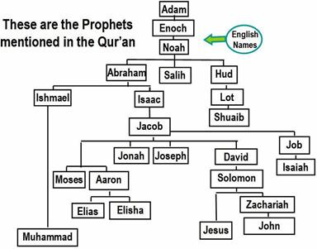
Islamic Teachings
Belief in one God: “Allah”
Made will known through 25 prophets, Muhammad being the latest and greatest
Deny Christ’s deity and His death on the cross
After judgment, men will either enjoy a sensual paradise or face the terrors of hell
Notes:
Islam is a monotheistic religion just like Christianity (though in their ignorance they claim our belief in a 3-person God-head is polytheistic).
Islam claims God made His will known through 25 prophets of whom Muhammad is the latest and greatest. Some of these are individuals we recognize from the bible though the Koran calls many by Arabic names instead of Jewish names.
Though Muslims claim Jesus was one of the prophets, they deny His deity and His death, burial, and resurrection. They believe God made it look like He was crucified by projecting either an image of Him on the cross or replacing Him with Judas (Muslims are divided over which). They believe Jesus was raised immediately to heaven.
Muslims believe that after judgment, men will either enjoy a sensual paradise or face the terrors of hell. Muslims believe that Christians are going to hell since it is, in their eyes, a false religion. We’re up to the challenge to show otherwise.

Slide 10
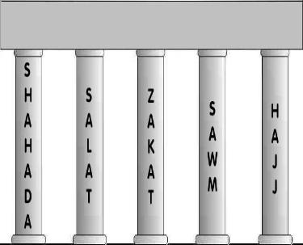
Islamic Teachings
5 Pillars of Islam…
Bearing witness that there is no god but Allah and Muhammad is his prophet
Praying five times daily
Giving charity to those in need
Fasting during the month of Ramadan
Making pilgrimage to Mecca
Notes:
There are five “pillars” of Islam that every good Muslim practices. All have Arabic names but are summarized as follows:
Bearing witness for Islam that there is no god but Allah and that Muhammad is his prophet
Praying 5 times a day toward Mecca
Giving charity to any in need
Fasting during the month of Ramadan
Making at least one pilgrimage to Mecca in their lifetime

Slide 11
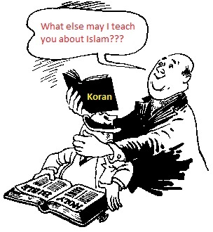
The Truth About Islam
Independent Thinking Forbidden
“O ye who believe! Ask not questions about things which if made plain to you, may cause you trouble. Some people before you did ask such questions, and on that account lost their faith.“”(Surah 5:101-102).
“The Holy Prophet himself forbade people to ask questions ...so do not try to probe into such things.” (The Meaning of the Qur'an, Maududi, vol. III, pgs. 76-77)
“The prophet was asked about things which he did not like, and when the questioner insisted, the Prophet got angry. (vol. 1, no. 92) The Prophet got angry and his cheeks or his face became red. (vol. 1, no. 91) "Allah has hated you...[for] asking too many questions.” (vol. 2, no. 555; and vol. 3, no. 591, Bukhari's Hadith commenting on Muhammad's reaction to hostile questioners.)
Notes:
The evidence for the bible is so overwhelming, immutable, and unshakable, Christians for centuries have been challenging skeptics to ask questions and consider the evidence. But like many cult religions, Islam strictly forbids the questioning of its religion and seeking out answers to its religion. That is why it is a religion that wins converts by force and not by objective reasoning. The evidence against it is so apparent that the only defense it can offer is to forbid its followers from questioning it.
Truth has nothing to hide. When any religions forbids the asking of questions or the challenge to its doctrines, it is revealing a lack of confidence the ability of its truth to convert the open mind.

Slide 12
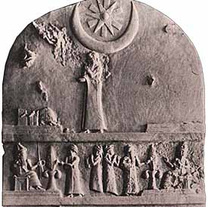
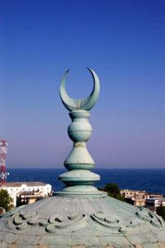
The Truth About Islam
Hubal the Moon God
Moon worship in Arabia dates as far back as 2200BC
In Mecca, the moon god was referred to as “Hubal”
The moon god was also referred to as “al-ilah” which means “the god”.
This was later shortened to “Allah” before Muhammad began promoting Islam
Muhammad repackaged pagan moon worship into monotheistic Islam
Notes:
The first picture depicting moon god worship dates to 2200 BC and was practiced in the Ur of Chaldees when Abraham left it for Canaan. Moon worship has been practiced in Arabia since 2000 BC. The crescent moon is the most common symbol of this pagan moon worship. In Mecca, there was a god named Hubal who was Lord of the Kabah. This Hubal was a moon god. One Muslim apologist confessed that the idol of moon god Hubal was placed upon the roof of the Kabah about 400 years before Muhammad. This may in fact be the origin of why the crescent moon is on top of every minaret at the Kaba today and the central symbol of Islam atop of every mosque throughout the world:
About four hundred years before the birth of Muhammad one Amr bin Lahyo ... a descendant of Qahtan and king of Hijaz, had put an idol called Hubal on the roof of the Kaba. This was one of the chief deities of the Quraish before Islam. (Muhammad The Holy Prophet, Hafiz Ghulam Sarwar (Pakistan), p 18-19, Muslim)The moon god was also referred to as "al-ilah". This is not a proper name of a single specific god, but a generic reference meaning "the god". Each local pagan Arab tribe would refer to their own local tribal pagan god as "al-ilah".
“Al-ilah" was later shortened to Allah before Muhammad began promoting his new religion in 610 AD. There is evidence that Hubal was referred to as "Allah". When Muhammad came along, he dropped all references to the name "Hubal" but retained the generic "Allah". Muhammad retained almost all the pagan rituals of the Arabs at the Kabah and redefined them in monotheistic terms.
Regardless of the specifics of the facts, it is clear that Islam is derived from paganism that once worshiped a moon-god. Although Islam is today a monotheist religion, its roots are in paganism.
It is clear, from a historical point of view, that Muhammad, as a youth participated in worshipping all the 360 pagan gods in the Kabah in Mecca owned and operated by the Quraish tribe to which Muhammad was member in good standing. As Muhammad grew up, he was influenced by Christians (monotheists) who condemned the polytheism at the Kabah. At some point in Muhammad's life, he was convinced by the Christians that Polytheism was wrong and sought to reject the 360 pagan gods he had grown up with. Muhammad was converted to the concept of monotheism through the influence and teachings of Christians. However, being a proud "nationalistic cultural Arab", bent to preserve his traditions, Muhammad, decided to "reform" his native pagan religion, rather than adopt a completely different religion like Christianity. So Muhammad took the top pagan god of the Kabah in Mecca (called Hubal and/or Allah) and chose it to be his new monotheistic god. This god was already considered the top god among other gods at the Kabah. Muhammad's strategy was simple. Rather than converting all the Arab people to the monotheism of Christianity, Muhammad merely banished the other 359 pagan gods and chose the one remaining to be the one and only god... what Muslims refer to today as "Allah". Thus Islam was born.

Slide 13
The Truth About Islam
Hubal the Moon God
Deut 4:19 – “And beware, lest you lift up your eyes to heaven and see the sun and the moon and the stars, all the host of heaven, and be drawn away and worship them and serve them, those which the Lord your God has allotted to all the peoples under the whole heaven.”
Deut 17:3 – “…and has gone and served other gods and worshiped them, or the sun or the moon or any of the heavenly host, which I have not commanded”
2 Kings 21:3 – “For he rebuilt the high places which Hezekiah his father had destroyed; and he erected altars for Baal and made an Asherah, as Ahab king of Israel had done, and worshiped all the host of heaven and served them.”
2 Kings 23:5 – “And he did away with the idolatrous priests whom the kings of Judah had appointed to burn incense in the high places in the cities of Judah and in the surrounding area of Jerusalem, also those who burned incense to Baal, to the sun and to the moon and to the constellations and to all the host of heaven.”
Jer 8:2 – “And they will spread them out to the sun, the moon, and to all the host of heaven, which they have loved, and which they have served, and which they have gone after, and which they have sought, and which they have worshiped.”
Jer 19:13 – “And the houses of Jerusalem and the houses of the kings of Judah will be defiled like the place Topheth, because of all the houses on whose rooftops they burned sacrifices to all the heavenly host and poured out libations to other gods.”
Zeph 1:5 – “And those who bow down on the housetops to the host of heaven.”
Notes:
The Old Testament is filled with verses condemning the worship of the hosts of heaven (sun, moon, stars, planets, etc.). In many of these verses, the moon is called out specifically. This is proof that moon worship was practiced by pagan tribes of that day. As with any object created by God, to worship it and assume it divine is idolatry and abhorrent to God.

Slide 14
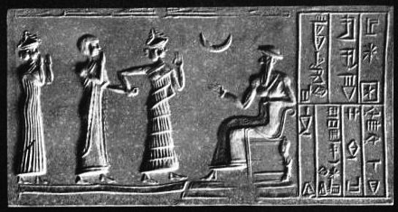
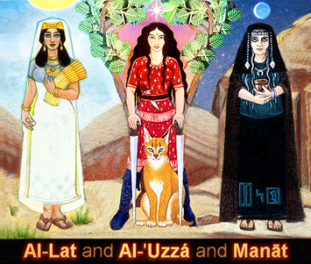
The Truth About Islam
Daughter-gate
Moon worship in Arabia dates as far back as 2200BC
In Mecca, the moon god was referred to as “Hubal”
The moon god was also referred to as “al-ilah” which means “the god”
This was later shortened to “Allah” before Muhammad began promoting Islam
Muhammad repackaged pagan moon worship into monotheistic Islam
Notes:
Muslims today do not worship Allah's daughters and view them as pagan deities. Having said that, it is important to note that Muhammad himself commanded his followers to offer prayers to these "Allah's daughters". He later retracted it and blamed it on the Devil. It is this true event in Muhammad's life which was the topic of Salman Rushdie's book, "The Satanic Verses." (a book we certainly do not recommend reading for its profanity and racism.)
It is an undeniable fact of history that before Muhammed was born, the moon god "al-Ilah" (Allah) had three daughters named al-Lat, al-Uzza and Manat. The first two were even named after their father. Each daughter had a separate shrine near Mecca, where Allah's shrine was located.
Accoding to Muhammad, as he grew weary from evangelizing his new religion with little success, he was tricked by the devil into adding a verse in the Koran that commanded Muslims to pray to Allah's three pagan daughters Lat, Uzza and Manat. The pagan female trinity was immediately accepted without dissent and the passage was considered part of the revealed Koran. However some time later, Muhammad supposedly got a revelation from God that the verse should be removed. After repenting of the error, Muhammad was comforted by God.
Such "after the fact corrective revelations" are very common with cults. Joseph Smith, founder of the Mormons also received an "after the fact corrective revelation" from God retracted the previous "divine command" allowing polygamy.
The historical information confirming the "Satanic verses" is so vast and sure, only the desperate blind would deny the evidence. Undeniably factual information regarding the Satanic verses comes from respected Muslim scholars like at-Tabari and Ibn Sa'd who wrote biographical and historical accounts of the life of Muhammad.
Yet some Muslims actually reject the whole "daughter-gate" story as untrue. These are an extremist minority, the ones who don't believe youth should be taught history or science, but spend 8 hours a day memorizing the Koran. Yet many Muslims are trained to habitually disregard factual world history when it conflicts with the Koran. Take the fact of Christ's crucifixion. Even the Jews agree he was crucified, but the Koran says it was a case of mistaken identity. So Muslims reject the universal record of history and the Bible, but believe the Koran is true. Amazingly, some Islamic apologists actually deny "daughter-gate" ever happened. Yet their only argument is, "The Koran says it cannot be tampered with and that Satan cannot interfere with the revelation process." So, these extremists must either admit that the final prophet revealed a Koranic passage whose origin was Satan, or simply rewrite their own history and deny the whole "daughter-gate" scandal itself.

Slide 15
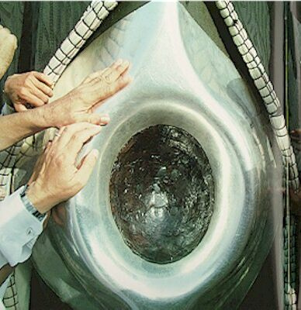
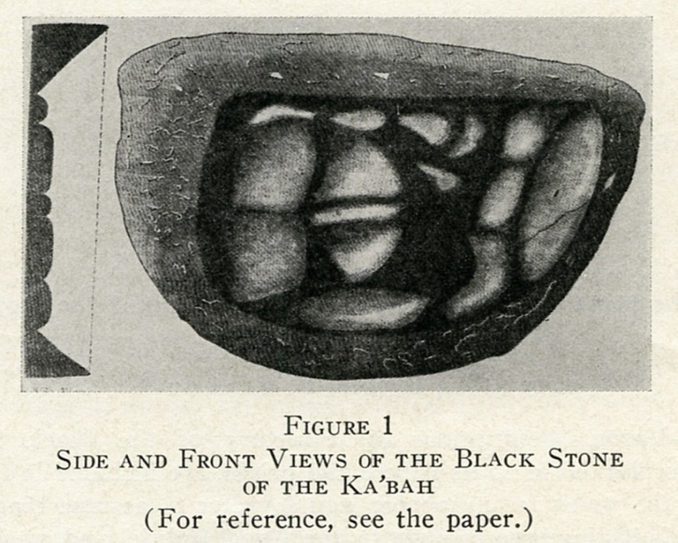
The Truth About Islam
Meteorite worship
Muslims believe that the revered “black stone” is a special divine meteorite predating creation that fell at the foot of Adam and Eve
Embedded in the southeastern corner of the Kabah
Muslims touch and kiss the black stone during Hajj
Pagan Origin: Every local tribe of Arab Pagans kissed their own tribal black stones.
Acts 19:35 – “After quieting the crowd, the town clerk said, “Men of Ephesus, what man is there after all who does not know that the city of the Ephesians is guardian of the temple of the great Artemis and of the image which fell down from heaven?”
Notes:
Muslims believe (without proof) that the revered “black stone” (Alhajar Al-Aswad) is a meteorite, that pre-dates creation and fell at the foot of Adam and Eve. It is presently embedded in the southeastern corner of the Kabah. Muslims touch and kiss the black stone during Hajj but non-Muslims are strictly forbidden to even touch it. The stone has been attacked many times and is now composed of several pieces and fragments, bound together by a silver ligature. It is semicircular and measures about ten inches horizontally and twelve inches vertically.
Narrated Salim that his father said: I saw Allah's Apostle arriving at Mecca; he kissed the Black Stone Corner first while doing Tawaf and did ramal in the first three rounds of the seven rounds (of Tawaf). (Sahih Bukhari 2.673)
Narrated 'Abis bin Rabia: 'Umar came near the Black Stone and kissed it and said "No doubt, I know that you are a stone and can neither benefit anyone nor harm anyone. Had I not seen Allah's Apostle kissing you I would not have kissed you." (Sahih Bukhari 2.667, Sahih Bukhari 2.675, Sahih Bukhari 2.676, Sahih Bukhari 2.679, Sahih Bukhari 2.680)
The reason behind this is that the pagan Arabs had the same ritual. Muhammad kept the same practice, and Umar did feel repugnant about the practice. However, he followed the practice of Muhammad.

Slide 16
Questions For Discussion Next Week
How should we respond to a religion that discourages questions?
What evidence should there be in our life that we’d die for our faith?
How should we attempt to convert a Muslim to Christianity?
Notes:
Here are our questions for next week:
What should be our response to a religion that discourages questions?
What evidence should there be in our lie that we’d die for our faith?
How should we attempt to convert a Muslim to Christianity?

Slide 18
Notes:
As we study church history, we want to be careful to make sure we learn the practical applications to help us in our walk with God today. History contains more than just stories, but also action/reactions that are similar to the issues we encounter in the 21st century. Learning where early Christians succeeded and failed will help us solidify our faith.

Slide 19
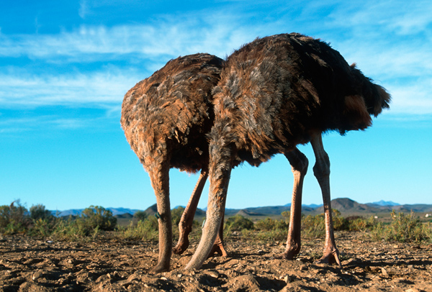
Practical Applications
1) How should we respond to a religion that discourages questions?

Slide 20
Practical Applications
1) How should we respond to a religion that discourages questions?
Remind them that the truth has nothing to hide
John 3:19-21 – “¹⁹This is the judgment, that the Light has come into the world, and men loved the darkness rather than the Light, for their deeds were evil. ²⁰For everyone who does evil hates the Light, and does not come to the Light for fear that his deeds will be exposed. ²¹But he who practices the truth comes to the Light, so that his deeds may be manifested as having been wrought in God.”
“If every religion had that policy, how could we evangelize?”
Rom 2:21 – “You, therefore, who teach another, do you not teach yourself?”
Remind them that this is an issue of heaven/hell in which every person must given an account of himself/herself
Gal 1:9 – “As we have said before, so I say again now, if any man is preaching to you a gospel contrary to what you received, he is to be accursed!”
2 Cor 5:10 – “For we must all appear before the judgment seat of Christ, so that each one may be recompensed for his deeds in the body, according to what he has done, whether good or bad.”

Slide 21
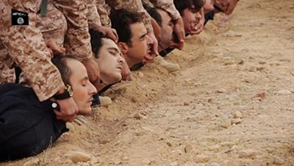
Practical Applications
2) What evidence should there be in our life that we’d die for our faith?

Slide 22
Practical Applications
2) What evidence should there be in our life that we’d die for our faith?
Faithful in the little things
Luke 16:10 – “He who is faithful in a very little thing is faithful also in much; and he who is unrighteous in a very little thing is unrighteous also in much.”
Loyalty in Christ outweighs all other loyalties
Matt 10:37 – “He who loves father or mother more than Me is not worthy of Me; and he who loves son or daughter more than Me is not worthy of Me.”
We willingly endure suffering
Matt 5:10 – “Blessed are those who have been persecuted for the sake of righteousness, for theirs is the kingdom of heaven.”

Slide 23
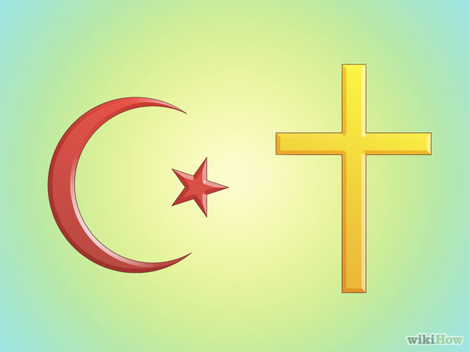
Practical Applications
How should we attempt to convert a Muslim to Christianity?

Slide 24
Practical Applications
How should we attempt to convert a Muslim to Christianity?
Understand the pressure of being a Muslim
1 Cor 9:19-22 – “¹⁹For though I am free from all men, I have made myself a slave to all, so that I may win more. ²⁰To the Jews I became as a Jew, so that I might win Jews; to those who are under the Law, as under the Law though not being myself under the Law, so that I might win those who are under the Law; ²¹to those who are without law, as without law, though not being without the law of God but under the law of Christ, so that I might win those who are without law. ²²To the weak I became weak, that I might win the weak; I have become all things to all men, so that I may by all means save some.”
Be ready to make a defense
1 Pet 3:15 – “But sanctify Christ as Lord in your hearts, always being ready to make a defense to everyone who asks you to give an account for the hope that is in you, yet with gentleness and reverence.”
Let God’s word do its job
Heb 4:12 – “For the word of God is living and active and sharper than any two-edged sword, and piercing as far as the division of soul and spirit, of both joints and marrow, and able to judge the thoughts and intentions of the heart.”

